Slide 1
Moving to the Next Stage
Sharon P. Douglas, MD
Pulmonary/Critical Care
Professor of Medicine
Associate Dean for VA Education

Slide 2
Welcome to the Last Great Senior Year
You are no longer an M3.
You become an acting intern on most rotations.
You are responsible for your patients.
You are poised to help the M3s behind you.
Learn to take full responsibility.
Start your MD habits NOW.
Learn to give and receive feedback correctly.

Slide 3
Professionalism Pillars
Respect
Empathy
Honesty
Decorum
Punctuality
Collaboration
Accountability
Confidentiality

Slide 4
Characteristics of Professionalism
Competence Accountability
Keeping commitments No bullying
Language No gossiping
Leave drama at home Appearance
Positive attitude
Treat everyone with the same respect
Emotions-stay poised and cool under pressure
No lying, cheating, stealing, and other ethical lapses
No jokes or sexual innuendos

Slide 5
Professionalism
Skill, good judgment, and polite behavior expected from a person trained to do a job well.
Shown by how you speak, listen, write and respond to emails or texts.
***What you know
***How you do your job
***How you behave
***How you come across
***How you dress

Slide 7
Character
Is Who You are When No One is Looking

Slide 8
Read your emails
Make appointments
Respond to your Assigned Dean
Show Up for Rotations
Be responsible for your patients
Be available
After you have matched, be sure to do all the your residency program requires-timely!

Slide 9
Feedback and Self Reflection

Slide 10
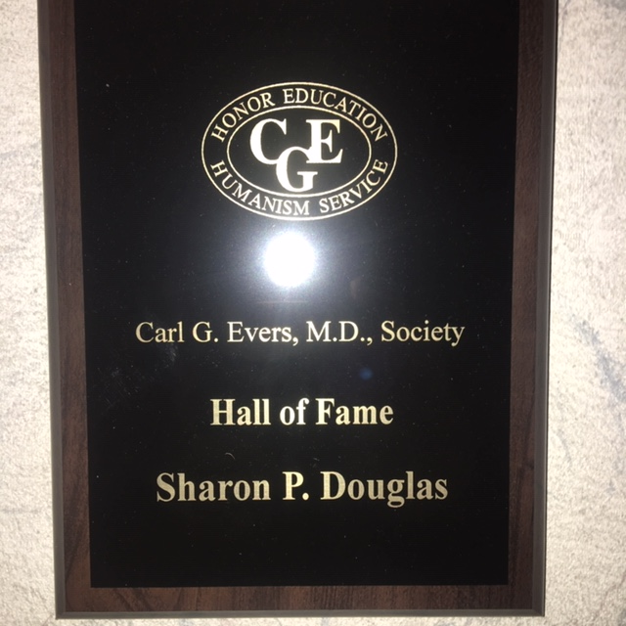
What is feedback?
Communication about a process,
with the goal of improvement
Verbal or nonverbal

Slide 11
What is evaluation?
Setting a value of
something in a
thoughtful manner
Appraisal

Slide 12
What needs improvement

Slide 13
When delivered in a positive, constructive way, you can communicate something negative without offending or putting the other person on the defensive.
At the same time, you help
solve the problem,
change behavior, and
work towards established goals.
The degree to which you’re successful at this will indicate how good your interpersonal skills are.

Slide 15
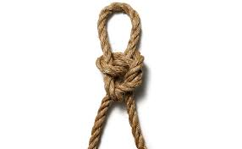
A randomized control trial of medical student reactions to feedback.
2 groups of M2 and M3 students taught
how to tie 2-handed surgical knots
Group 1 got specific, constructive feedback
on how to improve
Group 2 received general compliments
Satisfaction Group 2 > Group 1
Performance Group1 > Group 2
“An investigation of medical student reactions to feedback: a randomised controlled trial” Boehler, Margaret L., Rogers, David A., Schwind, Cathy J. el.al Medical Education 2006; 40: 746-749 Blackwell Publishing Ltd 2006.

Slide 16
What are the Characteristics of Good Constructive Feedback?
Honesty
Respectful
Clear
Objective
Supportive
Motivating
Given with the goal of improvement
Issue-specific
Action-oriented
Solution-oriented
Timely

Slide 17
How do I get feedback?
Ask for feedback and listen to what you hear with an open mind
What do I do with it?
Accept the comments in the spirit with which they are given.
Be professional. Take the actions to change.
Can I give feedback?
Absolutely, just keep in mind that it is issue specific and given to improve performance.

Slide 19
You will graduate from medical school but you will always be a student.
Start your good habits now……or improve on them.
S. Douglas, M37

Slide 22
POINTS TO REMEMBER
Find what you love and what you do well…….then, make that the mission of your life. Colin Powell

Slide 23
POINTS TO REMEMBER
The real art of conversation is not only to say the right thing at the right time, but also to leave unsaid the wrong thing at the tempting moment.

Slide 24
POINTS TO REMEMBER
Always be a little nicer than necessary.

Slide 25
POINTS TO REMEMBER
Be sure what you do each day is what you can sleep on each night.

Slide 26
POINTS TO REMEMBER
Laughter…..
is good medicine.

Slide 27
POINTS TO REMEMBER
Stuff……….. happens!!

Slide 28
POINTS TO REMEMBER
“WHAT LIES BEHIND US AND WHAT LIES BEFORE US ARE TINY MATTERS COMPARED TO WHAT LIES WITHIN US”.

Slide 29
POINTS TO REMEMBER
What you get by reaching your goals is not nearly as important as what you become by reaching them.

Slide 30
POINTS TO REMEMBER
Of all the things that we do as physicians, what our patients are most likely to remember is our compassion.

Slide 31
Watch your thoughts, they become words; Watch your words, they become action; Watch your actions, they become habits; Watch your habits, they become character; Watch your character, for it becomes your destiny.

